Slide 1
Insurance
Rate
Problem Statement:Management wants have better informed insurance agents.
Goal:Create a guid for the insurance agents
To help insurance rates
Based on customer characteristics
Task:Analysis: Hypothesis, and create a data story on key influencers of the insurance rate
Data: 1300 customers
Questions from Management:
1.What our customer typically look like?
2.What customer traits raise or lower insurance rates?
3. Do we typically charge more by gender?
4. What is the one trait that skyrockets cost?

Slide 2
Insight
Development
What is the goal of the business?
-make money in this case make insurance provider more knowledgeable
2. What is the metrics of success?
-insurance rate
3. What are the trends?
-relationships between variables and rates
4. What influences our metrics and trends?
- top three influencers

Slide 3
Tools &
Techniques
Tools: Excel And Powerpoint
Techniques: Regression Analysis, Univariate Analysis
Statistics : Mean, Median, Sum, Count, Coefficients
Visuals:Scatter plots, Bar Graphs, Box Plots
Data Types: Categorical, Continuous

Slide 4
What Is Average Customer Profile:
Average Rate:13270.42
Average BMI:30.6634
Average Age:39.20703

Slide 5
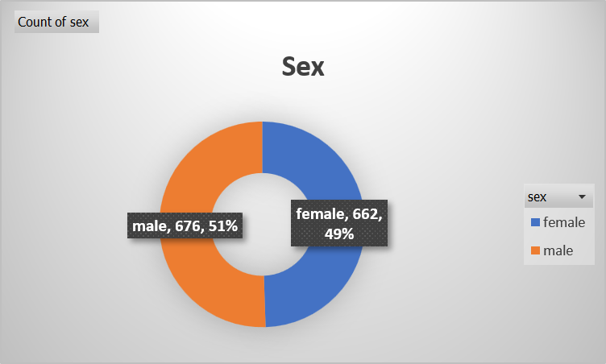
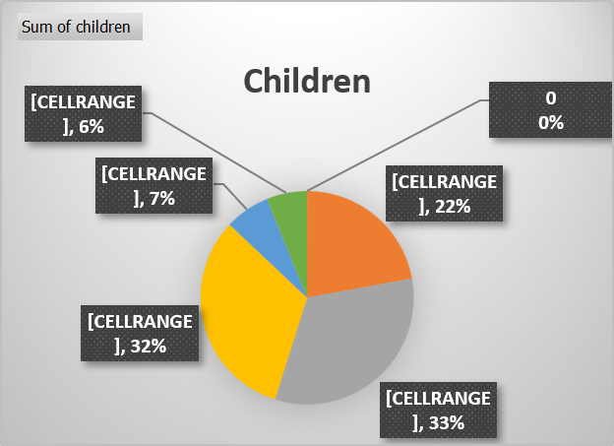
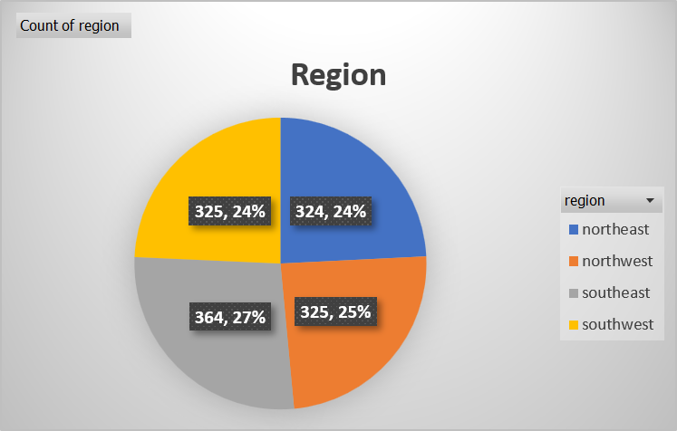
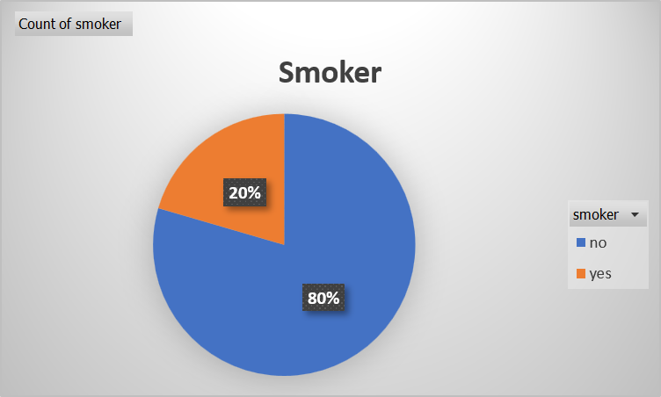

Slide 6
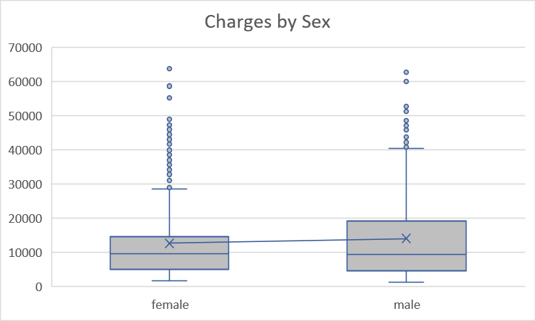
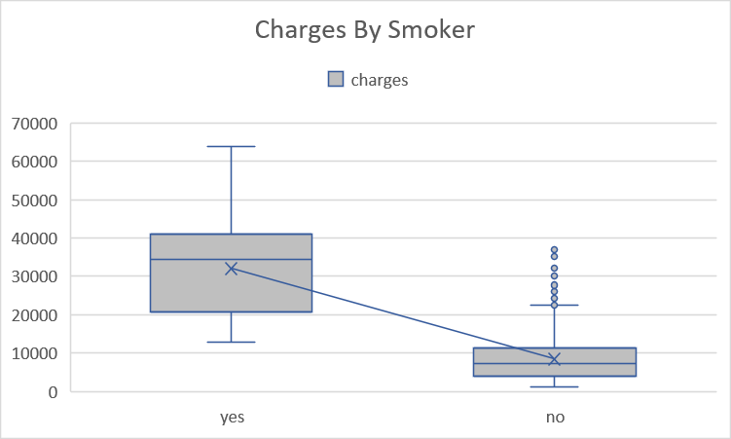
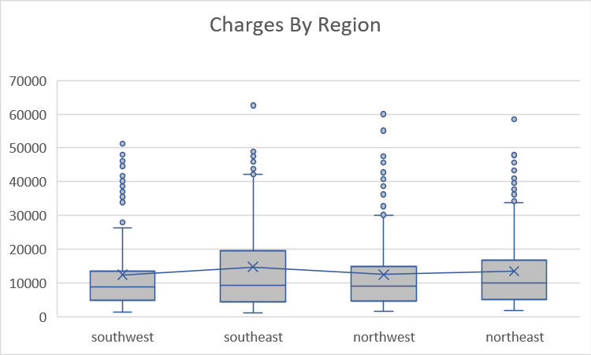
What Categories Have The Highest Charges?
Smokers have 4x higher charges
Male have a little bit highcharges
Southeast has the most highest charges

Slide 7
What is Multiple Linear Regression?
Multiple Linear Regression is a statistical technique used to predict a continuous outcome by analyzing the relationship between one dependent variable and multiple independent variables.
Purpose of this Model
Predict Medical Charges based on:
Age
BMI (Body Mass Index)
Number of Children
Gender
Smoking Status
Region
Regression Equation
Medical Charges=β0+β1(Age)+β2(BMI)+β3(Children)+β4(Gender)+β5(Smoker)+β6(Region)\text{Medical Charges)

Slide 8
How Well Does the Model Predict Medical Charges?
Metric | What It Means
R² = 0.751 | The model explains 75.1% of the differences in medical charges, meaning it predicts costs quite well. The remaining 24.9% is influenced by other factors not included in the model.
Significance F ≈ 0 | This tells us the model is statistically reliable. The relationship between the input variables and medical charges is very unlikely to be due to chance, so we can trust the model's results.

Slide 9
Variable | Coefficient | P-value | Interpretation
Smoker | 23,848.53 | <0.001 | Strongest predictor; smokers incur approximately $23,849 higher medical costs.
Age | 256.86 | <0.001 | Each additional year increases expected charges by about $257.
BMI | 339.19 | <0.001 | Each one-point increase in BMI increases costs by approximately $339.
Children | 475.50 | <0.001 | Each additional child increases expected charges by about $476.
Female | 131.31 | 0.693 | Not statistically significant.
Southwest | 74.97 | 0.873 | Not statistically significant.
Northwest | 682.06 | 0.155 | Not statistically significant.
Northeast | 1035.02 | 0.031 | Small but statistically significant effect.

Slide 10
Key Business Takeaways
🚭 Smoking status is the largest driver of medical expenses.
📈 Age and BMI are strong predictors of increasing healthcare costs.
👨‍👩‍👧 Number of children has a moderate positive effect.
⚖️ Gender and most regions do not significantly affect medical charges after accounting for other variables.

